Slide 1
베이즈 이론에 기반한 Kinect 센서를 통한 관심 사용자 인식 Interested player recognition through Kinect sensor based on Bayes Theorem
송 승 화

Slide 2
Goal
Kinect 센서가 감지한 플레이어 중에서
Kinect를 실제 이용하고 있을 확률이 높은 관심 플레이어를 인식 한다.
Find interested player who is most likely playing a game.

Slide 3
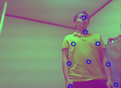
Data & Evidence
Location of joints in 3 degree coordinates
User location, distance to sensor, pattern of joints etc.

Slide 4
Subjectivity for Bayes theorem
Basically, the interested player will be center of sensor range for natural game play
관심 사용자는 원활한 게임 플레이를 위해 보통 센서의 가운데에 위치할 것이다.

Slide 5
Prior probability
When the number of player is N, we are to find only one interested player.
Each player’s prior probability is

Slide 6
Likelihood
Likelihood is based on Gaussian distribution of location
Each likelihood P(D|A), P(D|B), P(D|C)…is defined by the Gaussian distribution

Slide 7
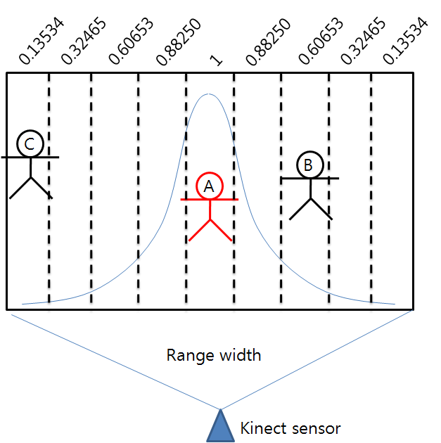
Actually used lookup table of the Gaussian

Slide 8
Applying Bayes Theorem
,
# of Detected player : 3

Slide 9
Evidence( P(D) )

Slide 10

When the evidence D is given, Probability P(A|D) that player A is the interested player

Slide 11


P(B|D), P(C|D)

Slide 12
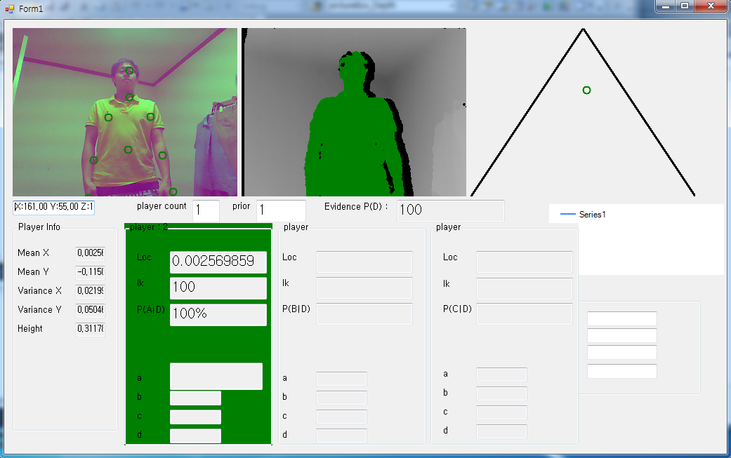
소프트웨어 구현 및 실험

Slide 13
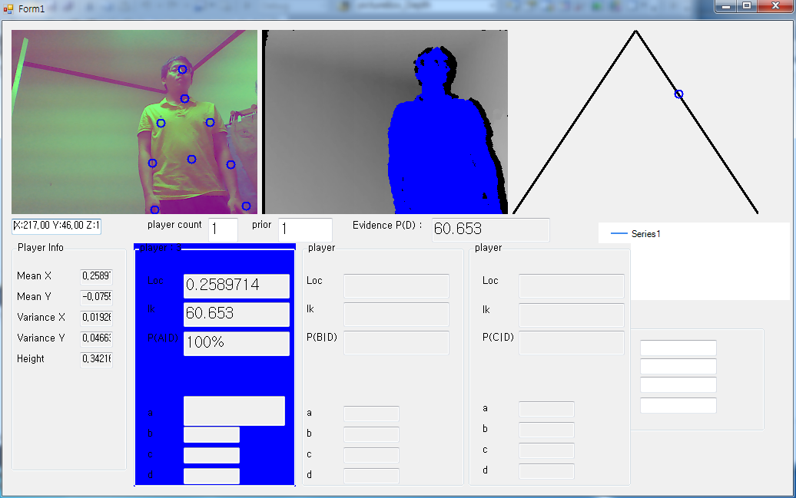
소프트웨어 구현 및 실험

Slide 14
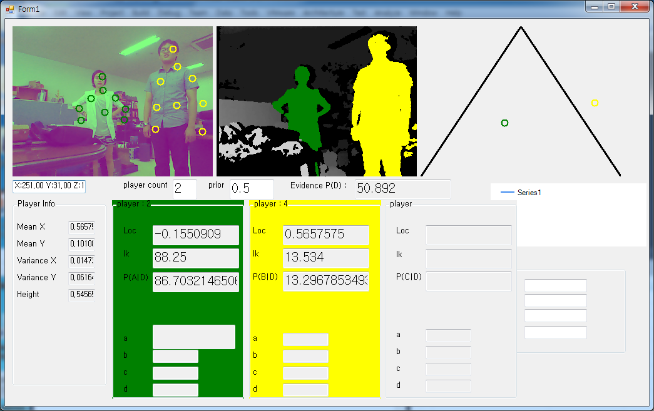
소프트웨어 구현 및 실험

